Slide 1

Getting started with Truffle - A development framework

Slide 2
Dapps Frameworks
Enhance productivity, automation, testing and other benefits
2 Frameworks
Truffle
Embark

Slide 3
Truffle Framework
Available in NPM package
Installation
npm install -g truffle
Prerequisite
Node Js 5.0+
Window, Linux, MacOS

Slide 4
Truffle CLI
Use Truffle CLI for common developer tasks like
Creating project
Solidity code compilation
Unit testing (Mocha and Chai)
Compilation & Migration

Slide 5
Truffle Package Manager Support
Packages for reusable code.
NPM
Default Package manager for Javascript Runtime Env. NodeJs
EthPM
Package registry for Ethereum.
Follows ERC 190 specification.
Standard for packaging distribution for Ethereum code.
Installation : truffle install <package name>@<version>
Still evolving

Slide 6
Developing Contract with Truffle framework
Project Setup
Truffle Boxes
Folder Structure
Iterative development of contracts
Using TDD approach
Compilation and Migration
Understand config files
On TestRPC

Slide 7
Project Setup : Truffle Boxes
Pre-built projects/boilerplates(http://truffleframework.com/boxes/ )
Use
Create a directory
Change the directory
Run either of these commands to download
truffle unbox <box name>
truffle init

Slide 8
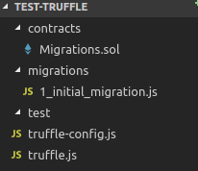
Project Setup : Folder Structure
Contracts
Migrations
Test
Build
truffle-config.js
truffle.js

Slide 9
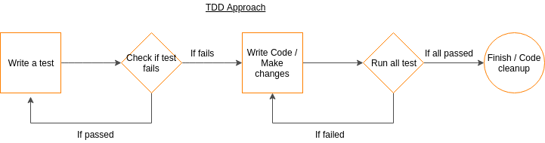
Test Driven Development
Process of developing automated test before actual development.
Also called Test First Development
Refactoring code i.e changing/adding some amount of code to the existing code without affecting the behavior of the code.
How to perform

Slide 10
Introduction to Mocha & Chai
Mocha
Javascript Testing framework, built on Node js
Functions to write test cases:
describe(...) : Grouping of test case
it(...) : used for describing the test case
before(...), beforeEach(..), after(...), afterEach(...)
Chai
Assertion library
Assertion styles : assert, except, should

Slide 11
Testing, Compilation and Migration
Test
> truffle test
Compile
> truffle compile

Slide 12
Migration
Migration
> truffle migrate
Other options
--network <name>
--f <number>
--reset
--verbose-rpc
--compile-all
truffle migrate --network development --reset

Slide 13
Summary
Initiate truffle box
Add contracts files to the contracts folder
Add the respective migration into the new migration file
Add the test cases into test folder
Update the configuration in truffle configs files
Truffle init
Truffle create contract <contract name>
Truffle create migration <any name>
Truffle compile
Truffle test
Truffle migrate

Slide 14
References
Truffle Framework
Embark Framework
EthPM - Ethereum Package Manager
Ethereum registry
Ethereum SC package specification : ERC 190
My blog on TDD
Mocha
Chai API

